Slide 1
Class 12
Export Policies by
Alan V. Deardorff
University of Michigan
2021
PubPol/Econ 541

Slide 2
Announcement
Quiz Scores
 | Q1 | Q2 | Q3 | Q4 | Q5
Mean | 8.97 | 7.21 | 6.50 | 8.66 | 9.00
Median | 9 | 7.5 | 6.5 | 9 | 9
Max | 10 | 9.5 | 9.5 | 10 | 10
Min | 6.5 | 4 | 4 | 5 | 7
S.D. | 1.09 | 1.70 | 1.72 | 1.31 | 0.83

Slide 3
Announcement
Tuesday, 10/19: No class (Fall Break)
Thursday, 10/21
  I’m revising the assigned reading, my paper “Trade Policy with Interacting Markets”
    Current version is fine for first few models, but I may make meaningful changes in later ones
  I’ll announce when the new version is posted.

Slide 4
Announcement
Quizzes
  Quiz 6 on NTBs & Export taxes this Thursday Oct 14
  No quiz Oct 21
  Quiz 7 Oct 28

Slide 5
Paper #1 Feedback
Rent is not deadweight loss
Why consumer cost per job saved
Discussion different for policy already in place than for a prospective one
Partial equilibrium and other markets:
  Not that they don’t exist or don’t matter
  Just that their prices are held fixed
I now suggest using 3 significant digits, not less
Report the elasticities that you use
Foreign lost sales are not a welfare loss
  Revenue falls, but so does cost.

Slide 6
For this Thursday
If you’ve time and interest,
  Read optional Scott and view optional Trade Talk, both on trade & women
  Read this week’s Economist articles (now linked to Canvas in syllabus)
    The urge to protect: How trade restrictions are being used as a tool to protect human rights
    Making trade greener: When environmental protection turns into trade protection
Think of ways that trade may hurt or help, such as
  Gender inequality
  Racial inequality
  Income and wealth inequality
  Environment
  Exploitation
  And more…?

Slide 7
Outline
Export policies
How common are they
Economic analysis
Empirics of export restrictions
Recent uses

Slide 8
Export policies
Types of export policies
  Bans
  Taxes
  Subsidies

Slide 9
Export policies
Reasons for export policies
  Bans
    To keep products away from other countries
    To lower prices to home consumers
  Taxes
    To raise revenue
    To lower prices to home consumers
  Subsidies (see later, Dec 7. Not GATT-legal)
    To support domestic producers

Slide 10
Outline
Export policies
How common are they
Economic analysis
Empirics of export restrictions
Recent uses

Slide 11
How common are export taxes
See Laborde et al.
Note first why they’ve been neglected:
  Countries mostly want to export more, not less
Export taxes are used by about 1/3 of WTO members
Average was 0.48% per cent in 2007
  This is less than half a percent. This must be an average of ones that are zero.

Slide 12
How common are export taxes
Export taxes are concentrated on
  Raw agricultural products
  Minerals
  Processed oilseeds
  Aluminum and iron
  Timber.
  Energy products (esp. Russia natural gas)

Slide 13
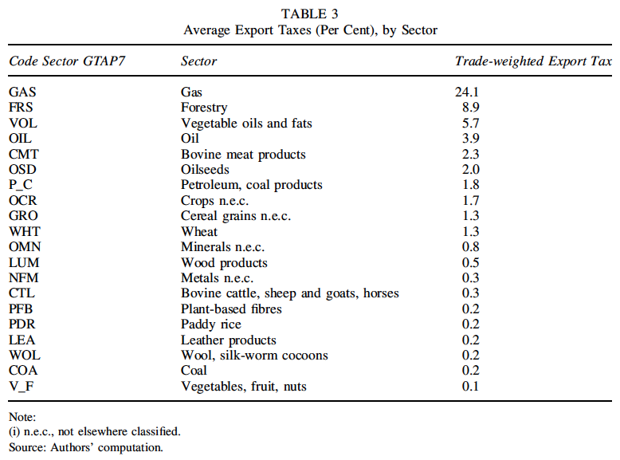
Note bias: High taxes cause less trade and lower weight.
Notes:
Laborde, David, Carmen Estrades, and Antoine Bouët, “A Global Assessment of the Economic Effects of Export Taxes,” The World Economy, 36(10), October, 2013, pp. 1333–1354.

Slide 14
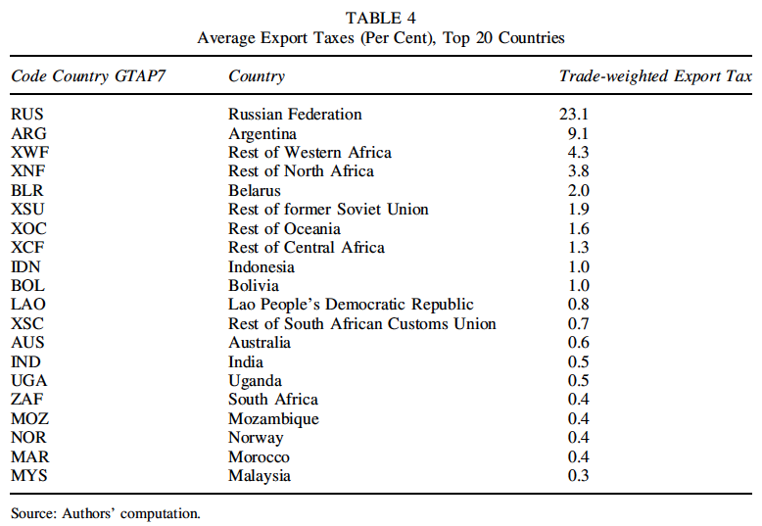
Notes:
Laborde, David, Carmen Estrades, and Antoine Bouët, “A Global Assessment of the Economic Effects of Export Taxes,” The World Economy, 36(10), October, 2013, pp. 1333–1354.

Slide 15
Pause for Discussion

Slide 16
  Questions on Laborde et al.
In 2006, what sector had the most export taxes?
What are some of the motives for export taxes mentioned?

Slide 17
Outline
Export policies
How common are they
Economic analysis
Empirics of export restrictions
Recent uses

Slide 18
Economic Analysis
Use the same tools and assumptions as for tariffs
Export tax causes domestic price to be below the world price by the amount of the tax (if country still exports)
Why? If suppliers continue to sell both at home and for export,
  They must get the same at home as for export
  And that is the world price minus the tax

Slide 19
Small country export tax
P
Effects of an export tax, starting from free trade
  Price falls
  Quantity demanded rises
  Quantity supplied falls
  Quantity of exports falls
  Tax revenue rises from zero
D
S
P₀=P_{W}
t
P₁=P_{W}–t
P_{aut}
X₀
D₀
D₁
S₁
S₀
Q
X₁
Specific Export Tax t

Slide 20
Small country export tax
P
Welfare effects of an export tax, starting from free trade
  Suppliers lose −(a+b+c+d+e)
  Demanders gain +(a+b)
  Government gains +d
  Country loses −(c+e)
D
S
P₀=P_{W}
c
e
t
a
d
b
f
P₁=P_{W}–t
P_{aut}
“Dead Weight Loss” =
X₀
D₀
D₁
S₁
S₀
Q
X₁
Specific Export Tax t

Slide 21
Small country export tax
P
Welfare effects of an export tax, starting from free trade
  Suppliers lose −(a+b+c+d+e)
  Demanders gain −(a+b)
  Government gains +d
  Country loses −(c+e)
D
S
P₀=P_{W}
c
e
t
a
d
b
f
P₁=P_{W}–t
P_{aut}
“Dead Weight Loss” =
X₀
D₀
D₁
S₁
S₀
Q
X₁
Specific Export Tax t

Slide 22
Large country, World Market
Welfare effects of a large-country tariff, starting from free trade
Home:
  Private sector (S&D) loses −(c+d)
  Government gains +(a+c)
  Country may gain or lose: +a−d
Foreign
  Private sector (S&D) loses −(a+b)
World loses −(b+d)
World Market
Home is Exporter
Foreign (*) is Importer
P
XS
P*₁
a
b
t
c
d
P₁
MD*
X₁=M*₁
X₀=M*₀
M*,X
“Dead Weight Loss” =

Slide 23
Large country, World Market
Thus large country, again, will gain from export tax if a>d
What is area a?
  The portion of the tax paid by foreign importers, who pay a higher price
  A transfer from foreign demanders to the home government
  The result, again, of improving the home country’s
  “terms of trade”
World Market
Home is Exporter
Foreign (*) is Importer
P
XS
P*₁
a
b
t
c
d
P₁
MD*
X₁=M*₁
X₀=M*₀
M*,X
“Terms of Trade” ≡ Relative price of exports = P^{X}/P^{M}

Slide 24
Pause for Discussion

Slide 25
  Questions
  (not asked about readings)
Explain why an export tax pushes down the price at home.
Explain why an export tax pushes up the price abroad.
Who are hurt and who are helped by an export tax?
Statement above said
  “Export tax causes domestic price to be below the world price by the amount of the tax (if country still exports)”
  What happens if exports stop?

Slide 26
Outline
Export policies
How common are they
Economic analysis
Empirics of export restrictions
Recent uses

Slide 27
Empirics
Laborde et al.
  Use computer model of trade to quantify the effects of removing export taxes that existed in 2007
  (CGE Model = Computable General Equilibrium Model)

Slide 28
Empirics
Findings: Export tax removal causes
  an overall gain of 0.24 per cent in world real income
    +1.6 per cent in oil-exporting countries,
    +0.2 per cent in developed countries and
    +0.1 per cent in other developing countries.
  boosts world trade volumes by 2.8 per cent
  reduces the world price of these products.

Slide 29
Empirics
Findings
  The largest winner is the CIS block (whose real income increases by 3.5 per cent)
  Other oil exporters are negatively hit
  Importing countries can benefit
  May cause deindustrialization
  Despite their much smaller size, export taxes effects on real incomes are more than half those of import taxes

Slide 30
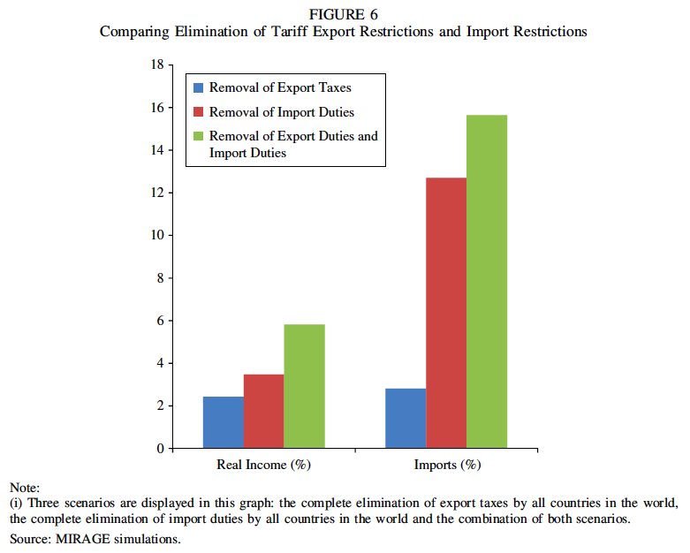
Notes:
Laborde, David, Carmen Estrades, and Antoine Bouët, “A Global Assessment of the Economic Effects of Export Taxes,” The World Economy, 36(10), October, 2013, pp. 1333–1354.

Slide 31
Empirics
Beckman et al.
  Reports effect of export taxes in agriculture, 2006-2008
  “In times of high or volatile prices, they are generally applied to guarantee domestic food supply and lower domestic prices.”
  Results from both a partial equilibrium model and a CGE model

Slide 32
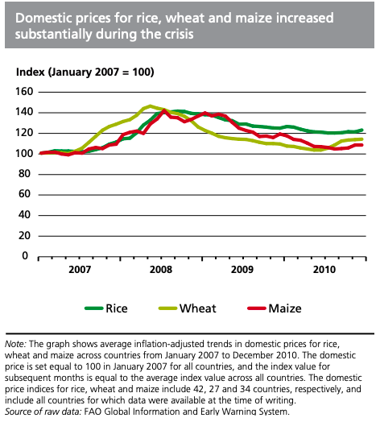
Notes:
FAO: “Lessons from the world food crisis of 2006–08”
http://www.fao.org/3/i2330e/i2330e04.pdf

Slide 33
Empirics
Effects of export taxes, Beckman et al.:
  lower domestic prices.
  increased international prices
    if exporter is large or if many exporters tax
  negative impacts on welfare
  countries that implemented these policies tended to weather the food-price crisis the best.
  countries that are dependent on food imports were not as insulated

Slide 34
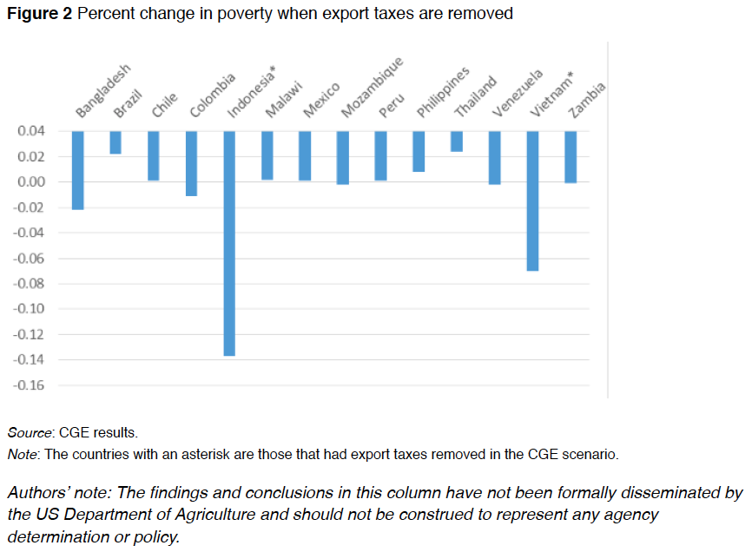
Note the zero line. This is an odd way to present results.
Notes:
Beckman, Jayson, Carmen Estrades, Manuel Flores, and Angel Aguiar, “The impacts of export taxes on agricultural trade,” VOX^{EU}, CEPR Policy Portal, October 3, 2018.
https://voxeu.org/article/impacts-export-taxes-agricultural-trade

Slide 35
Pause for Discussion

Slide 36
  Questions on Laborde et al., “Economic Effects of Export Taxes”
What are some of the main effects of removing export taxes?
What are some of the limitations of this analysis?

Slide 37
  Questions on Beckman et al., “Export taxes on agricultural …”
What was the main reason for export taxes examined here?
Can you tell from this whether the policies have the desired effects?
Does Figure 2 show poverty falling in all the countries?

Slide 38
Outline
Export policies
How common are they
Economic analysis
Empirics of export restrictions
Recent uses

Slide 39
Recent Uses
India: Banned all export of onions in 2020
  Due to drought, then rain, and resulting onion shortage
  Neighboring country consumers hit hard
Notes:
Gettleman, Jeffrey, Julfikar Ali Manik, and Suhasini Raj, “India Isnʼt Letting a Single Onion Leave the Country,” New York Times, October 1, 2019. [2p]
https://www.nytimes.com/2019/10/01/world/asia/india-modi-onion-prices.html

Slide 40
Recent Uses
Mozambique: Cashews
  Export tax of 18-22% on raw cashews
  Export tax of zero on processed cashews
  Purpose: to support processing industry
  Growers are hurt, but the processing industry has thrived
  Quality of raw cashews became “one of the lowest in the world”
Notes:
Economist, “Of cashews and cash: Mozambique’s nut factories have made a cracking comeback,” The Economist, September 12, 2019. [2p]
https://www.economist.com/middle-east-and-africa/2019/09/12/mozambiques-nut-factories-have-made-a-cracking-comeback

Slide 41
Recent Uses
Bans on export of sand
  Several countries
    Indonesia in 2003, Vietnam in 2010, Cambodia in 2017, Malaysia in 1997-2015, and again in 2020.
  Why?
    Mining threatens natural habitats
    Huge amounts needed for construction and land reclamation.
    Many countries but especially
      China
      Singapore
Notes:
Bruce-Lockhart, Chelsea, “Boom in global sand trade fuels fears over conservation,” Financial Times, December 30, 2019. [7p]
https://www.ft.com/content/aa614ec6-21ae-11ea-b8a1-584213ee7b2b

Slide 42
Recent Uses
Cocoa
  “Governments of Ghana and Ivory Coast formed a cocoa cartel that will charge an extra $400 per metric ton of the crop to give a better deal to farmers.”
  Why might this succeed?
    The two produce about 65% of the world’s cocoa.
    Smaller countries can’t serve the needs of the largest brands
Notes:
Ryan, Carol, “Cocoa Cartel Is Less Bitter for Luxury Chocolate,” Wall Street Journal, January 17, 2020. [3p]
https://www.wsj.com/articles/cocoa-cartel-is-less-bitter-for-luxury-chocolate-11579256986?mod=itp_wsj&ru=yahoo

Slide 43
Recent Uses
Rare earths (see Yu & Savastopolu)
  China may limit production and export of 17 rare earths
  It controls ~80% of world supply
  Crucial for many high-tech products
    Including American F-35 fighter jets
  Note:
    Trump had done this for “sensitive US technology, such as high-end semiconductors”
    Biden would too, together with allies

Slide 44
Recent Uses
Medical, PPE, Vaccines
  As we saw earlier, countries’ responses to pandemic often included export restrictions

Slide 45
Pause for Discussion

Slide 46
  Questions on
  Yu & Savastopolu
Would a limit on exports of rare earths matter only for weapons?
Why would an export limit be a “double edged sword”?
What has been suggested as a way for the US to protect itself from this?
Is China a net exporter of rare earths?

Slide 47
  Questions on
  Casey & Cimino-Isaacs
How does GATT/WTO treat export restrictions?
What countries have restricted exports of medical and PPE and when?
What are the economic effects of an export ban?
Have major groups of countries tried to deal with this?
Is the situation different for vaccines than it was for PPE and medical equipment?

